Slide 1
Mini Project Presentation
NTU Canteen Recommendation
Wu Sibing, Wu Ziang & Xiao Yang
16th November 2018

Slide 2
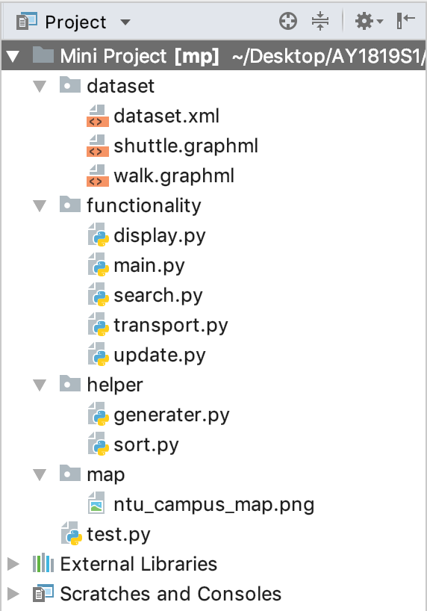
Project Decomposition

Slide 3
Feature - Search by Price

Slide 4
Project Decomposition

Slide 5
Project Decomposition

Slide 6
Project Decomposition

Slide 7
Project Decomposition

